Slide 1
Lecture 11 Graph Algorithms

Slide 2
Graphs
Vertices connected by edges.
Powerful abstraction for relations between pairs of objects.
Representation:
Vertices: {1, 2, …, n}
Edges: {(1, 2), (2, 3), …}
Directed vs. Undirected graphs.
We will always assume n is the number of vertex, and m is the number of edges.

Slide 3
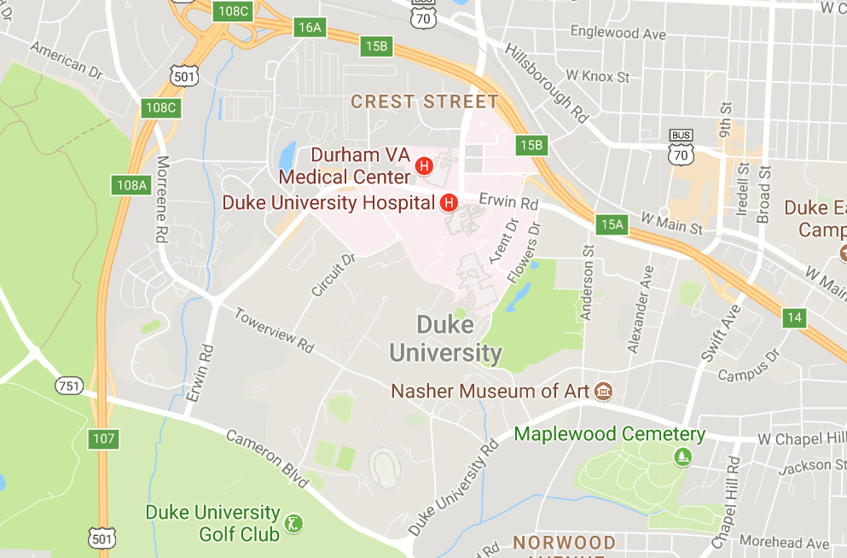
Graphs in real life and their problems
Traffic Networks
Vertices = ?
Edges = ?
Directed?
Typical Problems:
shortest path
Transportation (flows)

Slide 4
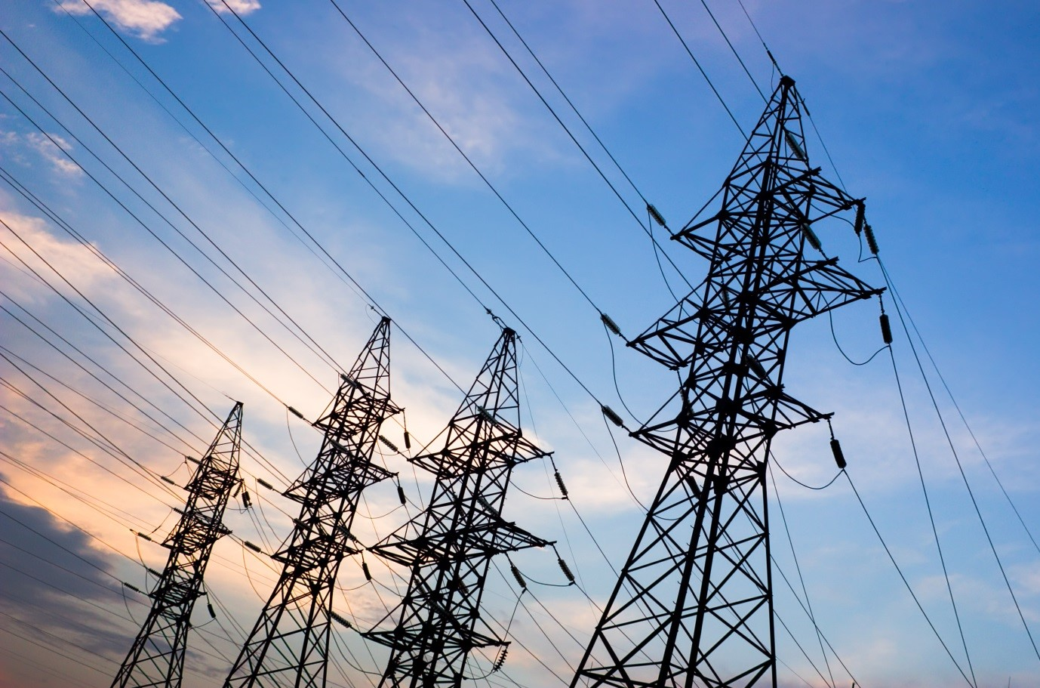
Graphs in real life and their problems
Electricity Networks
Vertices = ?
Edges = ?
Directed?
Typical Problems:
Minimum spanning tree
Robustness

Slide 5

Graphs in real life and their problems
Social Networks
Vertices = ?
Edges = ?
Directed?
Typical Problems:
Detecting communities
Opinion dynamics

Slide 6
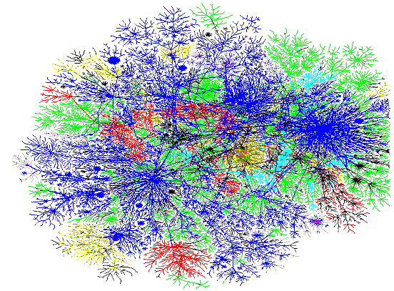
Graphs in real life and their problems
The Internet Graph
Vertices = ?
Edges = ?
Directed?
Typical Problems:
Page Rank
Routing

Slide 7
Focus
Understand the classical graph algorithms
Design idea
Correctness
Data structure and run time.
Know how to apply these algorithms
Identify the graph in the problem
Abstract the problem and relate to the classical ones
Tweak the algorithms
Apply the algorithms on a different/augmented graph.

Slide 8
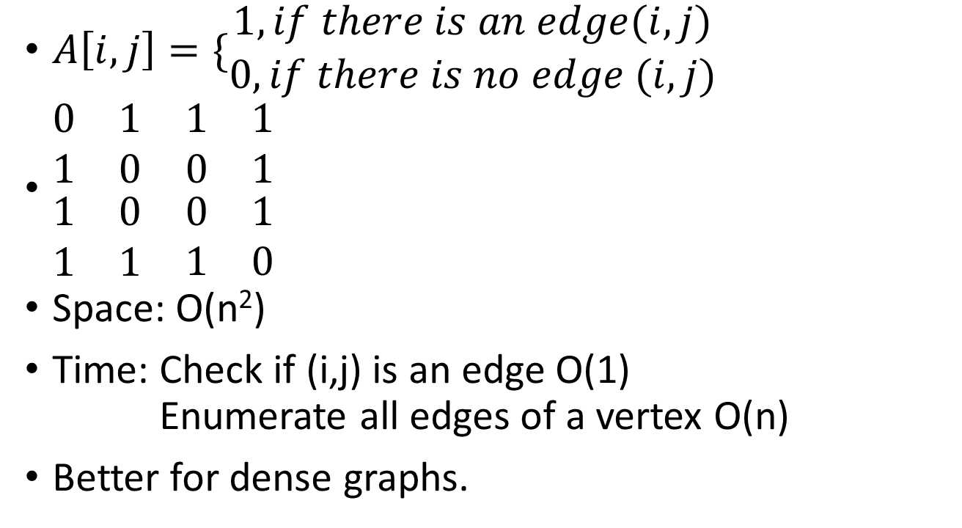
Representing Graphs – Adjacency Matrix
$A\left[i,j\right]=\{\begin{matrix}1, if there is an edge(i,j) \\ 0,if there is no edge (i,j)\end{matrix}$
$\begin{matrix}\begin{matrix}0 & 1 \\ 1 & 0\end{matrix} & \begin{matrix}1 & 1 \\ 0 & 1\end{matrix} \\ \begin{matrix}1 & 0 \\ 1 & 1\end{matrix} & \begin{matrix}0 & 1 \\ 1 & 0\end{matrix}\end{matrix}$
Space: O(n²)
Time: Check if (i,j) is an edge O(1) Enumerate all edges of a vertex O(n)
Better for dense graphs.
1
2
3
4

Slide 9
Representing Graphs – Adjacency List
Use a linked list for each vertex
Linked List store its neighbors
1: [2, 3, 4] 2: [1, 4] 3: [1, 4] 4: [1, 2, 3]
Space: O(m)
Time: Check if (i,j) is an edge O(n) Enumerate all edges of a vertex O(degree)
(degree of a vertex = # edges connected to the vertex)
Better for sparse graphs.
1
2
3
4

Slide 10
Representing Graphs
Getting faster query time?
If you don’t care about space, can store both an adjacency array and an adjacency list.
Saving space?
Can use a hash table to store the edges (for adjacency array).

Slide 11
Basic Graph Algorithm: Graph Traversal
Problem: Given a graph, we want to use its edges to visit all of its vertices.
Motivation:
Check if the graph is connected. (connected = can go between every pair of vertices) Find a path between two vertices Check other properties (see examples)

Slide 12
Depth First Search
Visit neighbor’s neighbor first.
DFS_visit(u)
Mark u as visited
FOR each edge (u, v)
IF v is not visited
DFS_visit(v)
DFS
FOR u = 1 to n
DFS_visit(u)

Slide 13
Depth First Search Tree
IF DFS_visit(u) calls DFS_visit(v), add (u,v) to the tree.
“Only preserve an edge if it is used to discover a new vertex”
1
1
2
3
2
3
4
4
5
5

Slide 14
DFS and Stack
Recursions are implemented using stacks
1
 |  | DFS(5) | DFS(4)
 | DFS(2) | DFS(2) | DFS(2) | DFS(3)
DFS(1) | DFS(1) | DFS(1) | DFS(1) | DFS(1)
2
3
4
5

Slide 15
Pre-Order and Post-Order
Pre-Order: The order in which the vertices are visited (entered the stack)
Post-Order: The order in which the vertices are last touched (leaving the stack)
Pre-Order: (1, 2, 5, 4, 3)
Post-Order: (5, 4, 2, 3, 1)
1
 |  | DFS(5) | DFS(4)
 | DFS(2) | DFS(2) | DFS(2) | DFS(3)
DFS(1) | DFS(1) | DFS(1) | DFS(1) | DFS(1)
2
3
4
5

Slide 16
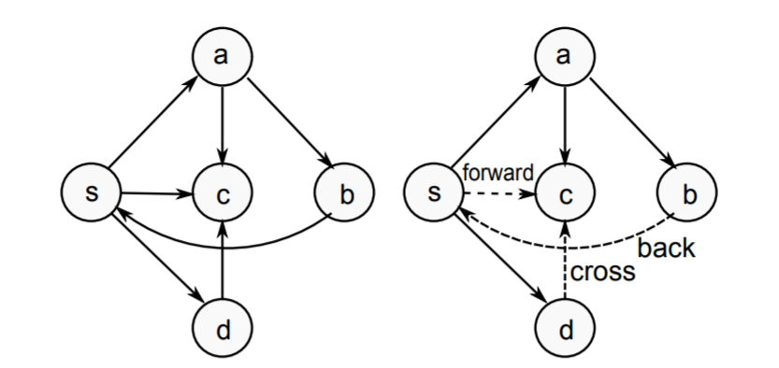
Type of Edges
Tree/Forward: pre(u) < pre(v) < post(v) < post(u)
Back: pre(v) < pre(u) < post(u) < post(v)
Cross: pre(v) < post(v) < pre(u) < post(u)

Slide 17
Application 1 – Cycle Finding
Given a directed graph G, find if there is a cycle in the graph.
What edge type causes a cycle?

Slide 18
Algorithm
DFS_cycle(u)
Mark u as visited
Mark u as in stack
FOR each edge (u, v)
IF v is in stack
(u,v) is a back edge, found a cycle
IF v is not visited
DFS_visit(v)
Mark u as not in stack.
DFS
FOR u = 1 to n
DFS_visit(u)

Slide 19
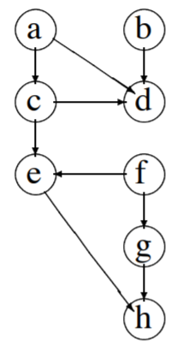
Application 2 – Topological Sort
Given a directed acyclic graph, want to output an ordering of vertices such that all edges are from an earlier vertex to a later vertex.
Idea: In a DFS, all the vertices that can be reached from u will be reached.
Examine pre-order and post-order
Pre: a c e h d b f g
Post: h e d c a b g f
Output the inverse of post-order!

